Slide 1

LOGISTIC REGRESSION

Slide 2

PRESENTATION PROGRESS
1. Applications of Logistic Regression (LR)
2. Binary Logistic Regression
3. Example – Healthcare Data
4. Model Validation
2

Slide 3
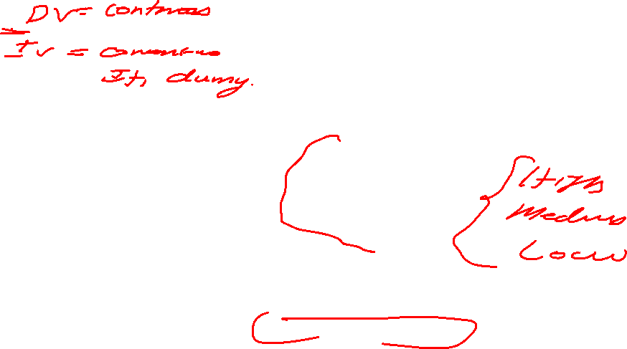
Linear Regression
Classification
Home prices
Weather
Stock price
Predicted value is continuous
Email is spam or not
Will customer buy life insurance ?
Which party a person is going to vote for?
Democratic
Republic
Independent
Predicted value is categorical

Slide 4

1.APPLICATIONS OF LOGISTIC REGRESSION
FRAUDULENT TRANSACTION : YES / NO
CUSTOMER CHURN : YES / NO
BINARY CLASS
EMAIL : SPAM / NOT SPAM
BINOMIAL LR
CREDIT CLASSIFICATION : LOW, MEDIUM AND HIGH RISK MULTI CLASS MULTINOMIAL LR

Slide 5


2. BINARY LOGISTIC REGRESSION

Slide 6
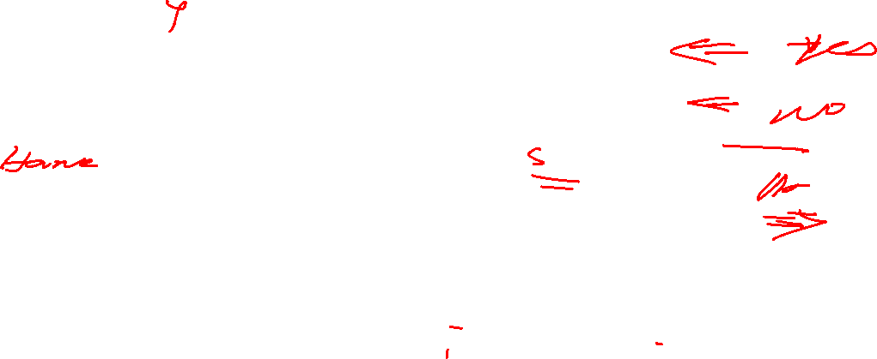
BINARY CLASSIFICATION – BINARY LOGISTIC REGRESSION
(YES) 1
Insurance ?
( Y )
Dependent Variable
(NO) 0
AGE
( X ) Independent Variable
5

Slide 7
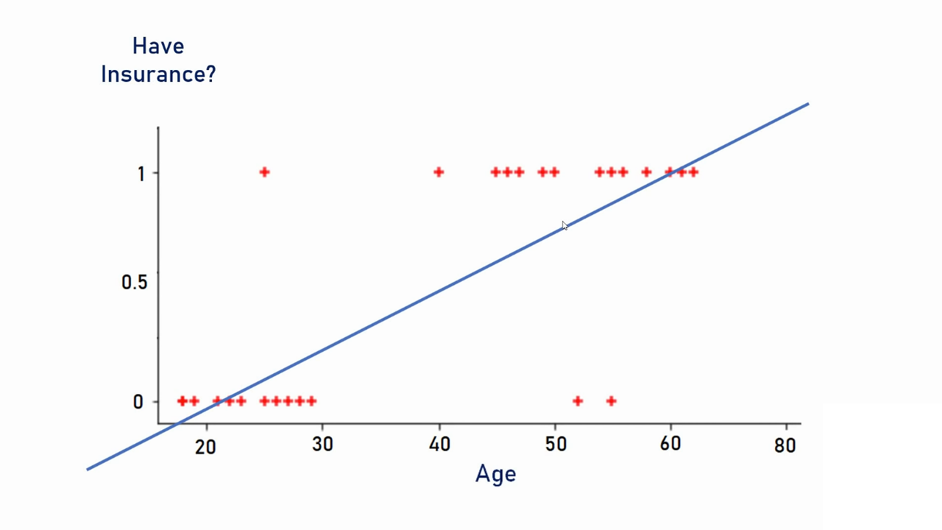

Slide 8
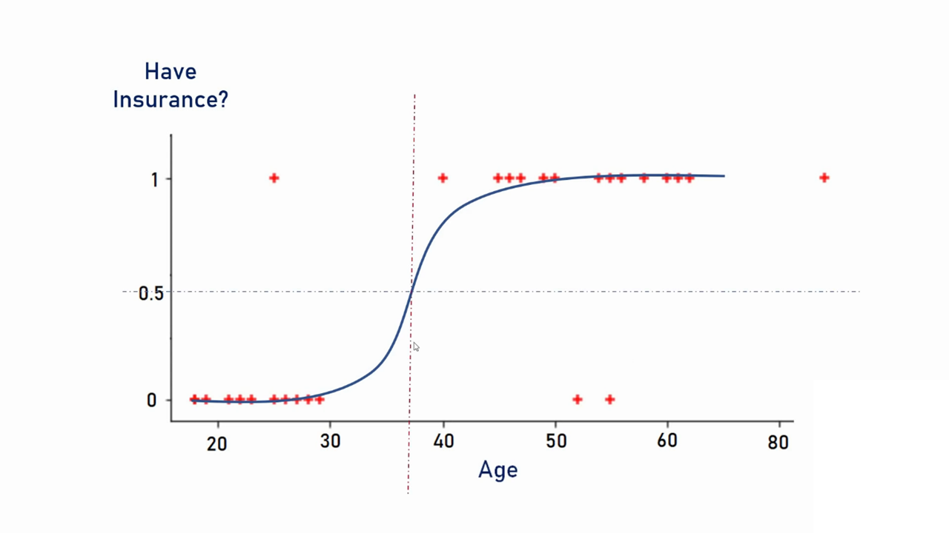


Slide 9
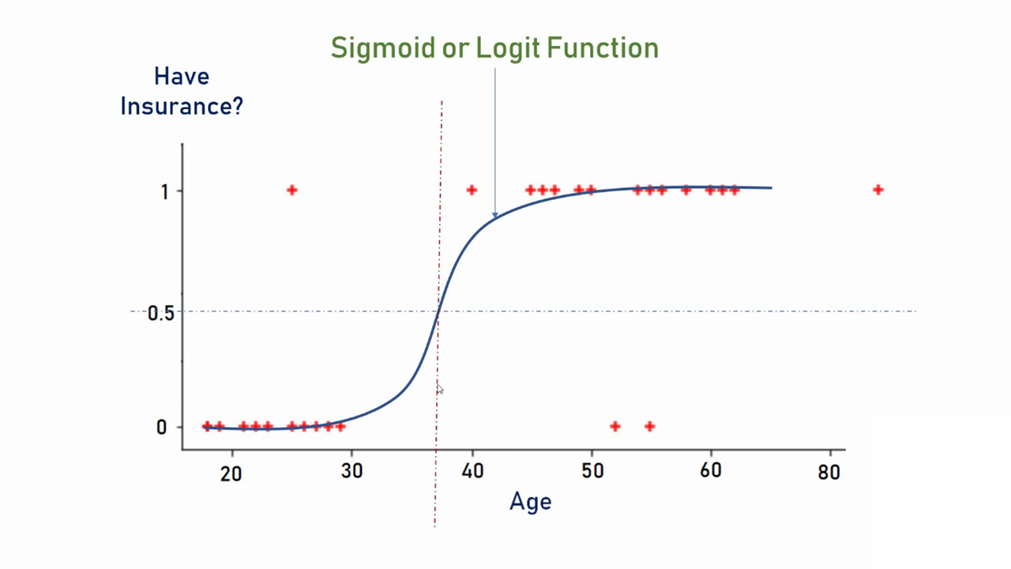


Slide 10
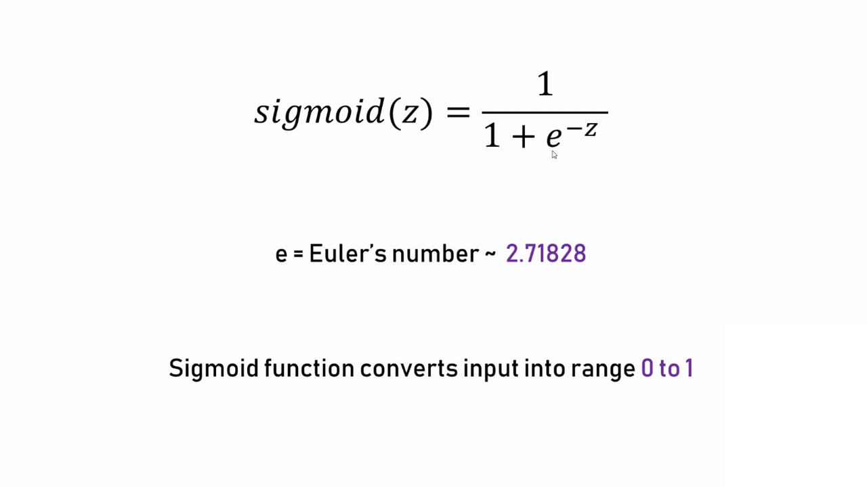
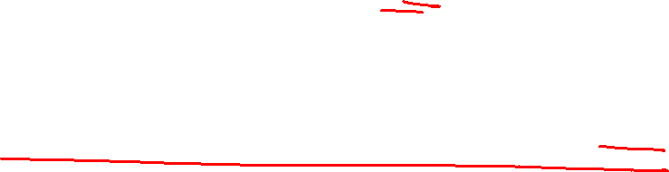

Slide 11
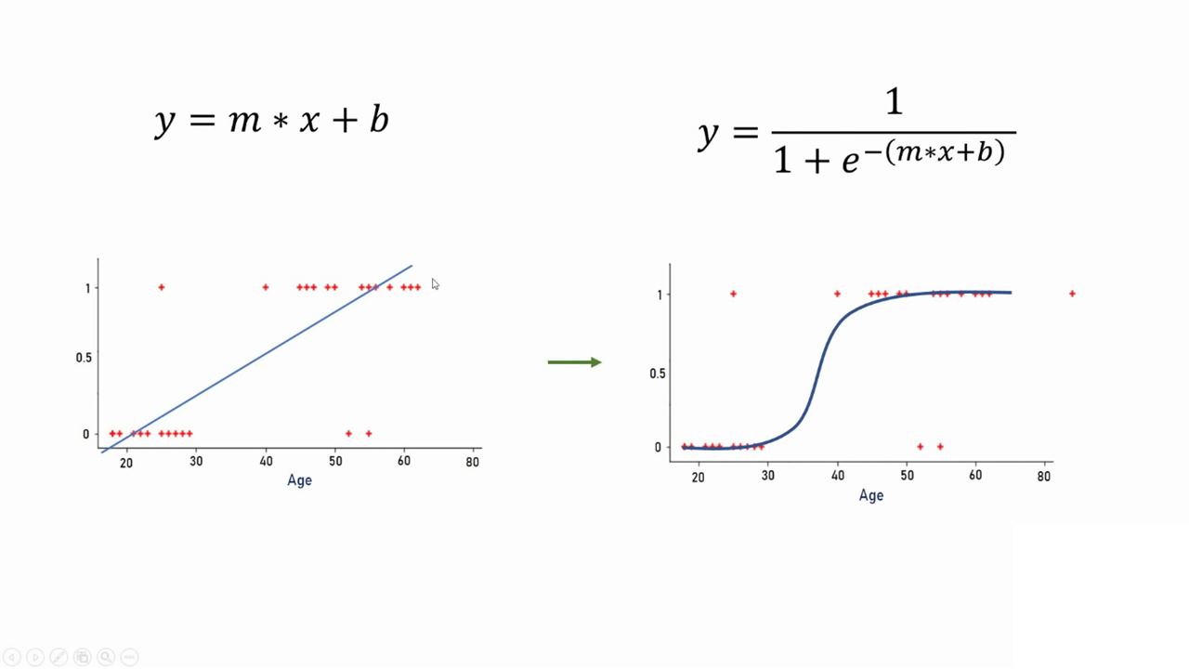


Slide 12
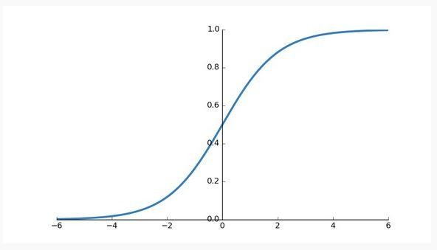
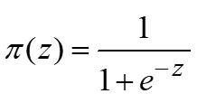
UNDERSTANDING THE LR MODEL
We can’t use linear function to estimate the parameters of LR.
SIGMOID FUNCTION (A.K.A) LOGISTIC FUNCTION
_{e}Z
1 + e^{Z}

Slide 13
LOGISTIC FUNCTION
The logistic or sigmoidal function can be given as
_{e}z
1
P(Y = 1) = π (z) =
− z ⁼
z
1+ e 1+ e
1
z = β₀ + β₁x₁ + β₂ x₂ + ... + β_{n}x_{n}
Remember, “y” is a categorical variable in LR. (ie) y є (0,1)
Actually, we are estimating the conditional probability of event (Y=1).

Slide 14
GENERALIZED LINEAR MODEL
Still, the function (equation 2 given below) is not a linear function!
exp(α+ βx)
P(Y = 1| X = x) =π(x) =
2
1+ exp(α+ βx)
Because the error distribution of outcome variable in Logistic Regression is not normal unlike in multiple linear regression(MLR)
One useful transformation for logistic regression is : “LOGIT TRANSFORMATION” a.k.a “Link Function”

Slide 15

LOGIT FUNCTION
exp(α+ βx)
Recall the equation 2 :
P(Y = 1| X = x) =π(x) =
1+ exp(α+ βx)
π_{i}
1− π_{i}
_{= e}( β₀ + β₁ X_{i} )
The above equation (2) can be transformed as :
Taking “ ln (Natural Log)” gives us:
Logit(π ) = ln( ^{π} ) = β₀ + β₁x
1− π
NATURAL LOG OF ODDS

Slide 16
EXCEL DEMO – PROBABILITY – NATURAL LOG OF ODDS
HANDS ON …

Slide 17


3. EXAMPLE
HEALTHCARE DATA

Slide 18
DATA – PRESENCE / ABSENCE OF DISEASE AND AGE
Patient Id | Age(x) | Disease(y)
1 | 25 | 0
2 | 29 | 0
3 | 30 | 0
4 | 31 | 0
5 | 32 | 0
6 | 41 | 0
7 | 41 | 0
8 | 42 | 0
9 | 44 | 1
10 | 49 | 1
Patient Id | Age(x) | Disease(y)
11 | 50 | 0
12 | 59 | 1
13 | 60 | 0
14 | 62 | 0
15 | 68 | 1
16 | 72 | 0
17 | 79 | 1
18 | 80 | 0
19 | 81 | 1
20 | 84 | 1
18

Slide 19



SCATTER PLOT
Disease(y) Vs Age (x)
1.2
1
0.8
0.6
0.4
0.2
0
Probability of Disease
0
10
20
30
40
50
60
70
80
90
Age
Prof. (Dr.) Sridhar Vaithianathan
19

Slide 20
ESTIMATION OF PARAMETERS
β₀ & β₁
Method : Maximum Likelihood Estimation (MLE)
n
Y ln[π(Z )]+
n
[ (Z ))]
LL =
∑ i i =1
∑
i =1
(1− Y )
ln(1−π
i
MLE : Likelihood of estimating the optimum co-efficient is maximized.
MLE gives the parameter value most favored by the observed data.
20

Slide 21
INTERPRETATION OF PARAMETERS
β₁
β = 0 implies that P(Y|x) is same for each value of x
β > 0 implies that P(Y|x) is increases as the value of x increases β < 0 implies that P(Y|x) is decreases as the value of x increases
21

Slide 22
LOGISTIC REGRESSION
HANDS ON …
22

Slide 23
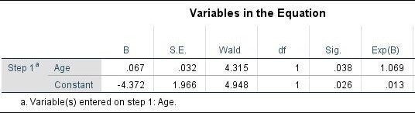

RESULTS AND INTERPRETATION
Let:
Y_{i} = 0 denote no disease AND Y_{i} = 1 denote disease
P(Y_{i} = 1) = Π_{i} &
P(Y_{i} = 0) = 1 - Π_{I}.
We have to estimate P(Y_{i} = 1 |X_{i}).
- 4.372 + 0.067 (Age)
17

Slide 24





exp(α+ βx)
Patient _ID | Age | Disease (Actual class) | Predicted Probability | Disease (Predicted class)
1 | 25 | 0 | 0.06308 | 0
2 | 29 | 0 | 0.08089 | 0
3 | 30 | 0 | 0.08601 | 0
4 | 31 | 0 | 0.09142 | 0
5 | 32 | 0 | 0.09713 | 0
6 | 41 | 0 | 0.16426 | 0
7 | 41 | 0 | 0.16426 | 0
8 | 42 | 0 | 0.17365 | 0
9 | 44 | 1 | 0.19372 | 0
10 | 49 | 1 | 0.25138 | 0
11 | 50 | 0 | 0.26419 | 0
12 | 59 | 1 | 0.39611 | 0
13 | 60 | 0 | 0.41223 | 0
14 | 62 | 0 | 0.44502 | 0
15 | 68 | 1 | 0.54511 | 1
16 | 72 | 0 | 0.61034 | 1
17 | 79 | 1 | 0.71452 | 1
18 | 80 | 0 | 0.72798 | 1
19 | 81 | 1 | 0.74103 | 1
20 | 84 | 1 | 0.77768 | 1
P(Y = 1| X = x) =π(x) =
1+ exp(α+ βx)
Predicted Probability
0.9
0.8
0.7
0.6
0.5
0.4
0.3
0.2
0.1
0
Probability of Disease
0
20
40
Age
60
80
100
18

Slide 25

4. MODEL VALIDATION
Omnibus Test (Likelihood Ratio Test)
Wald’s Test
Hosmer-Lomeshow Test Pseudo R-Square
19

Slide 26
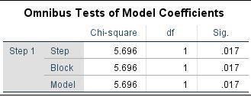
MODEL VALIDATION – OMNIBUS TEST
Omnibus tests are generic statistical tests used for checking whether the variance explained by the model is more than the unexplained variance.
The log likelihood function for binary logistic regression model is given by
n n
∑ i
Y ln[π(Z )]+
∑
i =1
[ (Z ))]
LL =
(1− Y )
ln(1−π
i
i =1
Equivalent to F-test (ANOVA) in MLR
20

Slide 27
MODEL VALIDATION – WALD STATISTIC
Wald’s test is used for checking statistical significance of individual predictor variables (equivalent to t-test in MLR model).
The null and alternative hypotheses for Wald’s test are:
H₀: β_{i} = 0
H₁: β_{i} ≠ 0
⎤ 2
⎥
⎡
∧
β_{i}
Equivalent to t-test in MLR model
W = ⎢
⎢ ⎥
∧
Wald’s test statistic is given by
⎢⎣ S_{e} (β_{i} ) ⎥⎦
27

Slide 28

MODEL VALIDATION – HOSMER-LOMESHOW TEST
Hosmer−Lemeshow (H−L) is a chi-square goodness of fit test used for checking
the goodness of logistic regression model (Hosmer and Lemeshow, 2000).
The null and alternative hypotheses in H−L test are
H₀: The logistic regression model fits the data
H₁: The logistic regression model does not fit the data
The H−L test statistic is given by:
G
⎡
(O_{k} − E_{k} )²
⎤
H = ∑ ⎢
⎥
k =1 ⎢⎣ ^{N}k^{π}k ^{(1 − π}k ⁾ ⎥⎦
28

Slide 29
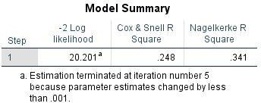
MODEL VALIDATION – PSEUDO – R SQUARE
It is not possible to calculate R² (as in the case of continuous dependent variable – MLR) in a logistic regression model. However, many pseudo R² values are used which compare the intercept-only model to the model with independent variables.
Cox and Snell R² is given by
Nagelkerke R²
is an adjustment over Cox and Snell R²,
so that the maximum value Pseudo R² is 1. Nagelkerke R² is given as follows:
⎧L(Intercept only model)⎫^{2/N}
2
R = 1 − ⎨
L(Full Model)
⎬
⎩
⎭
⎧L(Intercept- only model)⎫^{2/N}
1− ⎨
L(Full model)
⎬
R² =
⎩ ⎭
1−{L(Intercept - only model)}^{2/N}
23

Slide 30
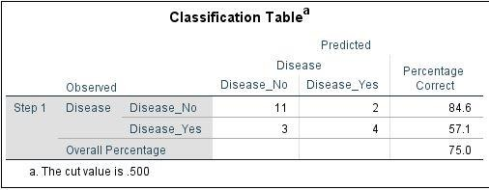
CLASSIFICATION MATRIX
24

Slide 31

LOGISTIC REGRESSION SUMMARY
Logistic regression is a classification Technique.
IT is not a linear function, so we make use of Sigmoid Function.
It is called as Generalized Linear Model.
In LR, we transform from probability to natural log of odds to overcome restricted range problem.
We are estimating the conditional probability of event (Y=1).
Model Diagnostics involve:
Omnibus Test (Similar to F-Test in MLR)
Wald Statistic (Similat to t-test in MLR)
Hosmer-Lomeshow Likelihood Ratio Test (Overall
Model Fit)
Psedo R-Square – Cox & Snell R-Sq and Nagerkerke
R-Square
Prof. (Dr.) Sridhar Vaithianathan
25

Slide 32
REFERENCES
David W. Hosmer and Stanley Lemeshow (2000). Applied Logistic Regression, Second Edition. John Wiley & Sons, Inc.
Galit Shmueli, Nitin R. Patel, and Peter C. Bruce. (2015), “Data Mining for Business Intelligence (Paperback),” Wiley India Pvt Ltd.
Agresti, A. (2002). Categorical Data Analysis. New York: John Wiley & Sons, Inc.
Dinesh Kumar, U. (2017).Business Analytics. Wiley India.
Daniel T. Larose and Chantal D. Larose. (2018). Data Mining and Predictive Analytics, Wiley.
26

Slide 33
✓

